Slide 1
Linear Regression Models
A Quick Overview
Dr. Kamesam

Slide 2
Regression Models
For all regression models, the Target variable must be a continuous, numeric variable
For Linear Regression, all the independent variables must also be continuous, numeric variables.
If an independent (explanatory) variable is categorical, then there are ways to pre-process the data so that you can still use regression analysis.
examples of categorical (Gender, color etc.)

Slide 3
Dataset: Sample 0f 30 houses

Slide 4
Correlation vs. Regression
A scatter diagram can be used to show the relationship between two variables
Correlation analysis is used to measure strength of the association (linear relationship) between two variables
Correlation is only concerned with strength of the relationship
No causal effect is implied with correlation

Slide 5
Correlation Coefficient
Also known as Pearson Correlation Coefficient
-1 <= r <= +1
r = -1 , if the correlation (association) perfect and –ve.
r = +1 if the correlation is perfect and +ve
In EXCEL, Data -> Data Analysis -> Correlation

Slide 6
Types of Relationships
Linear relationships
Curvilinear relationships
Y
Y
X
X
Y
Y
X
X

Slide 7
Types of Relationships
(continued)
Strong relationships
Weak relationships
Y
Y
X
X
Y
Y
X
X

Slide 8
Types of Relationships
(continued)
No relationship
Y
X
Y
X

Slide 9
Examples of Approximate r Values
Tag with appropriate r value:
0, 1, -1, +0.3, -0.6
y
y
y
x
x
x
y
y
x
x

Slide 10
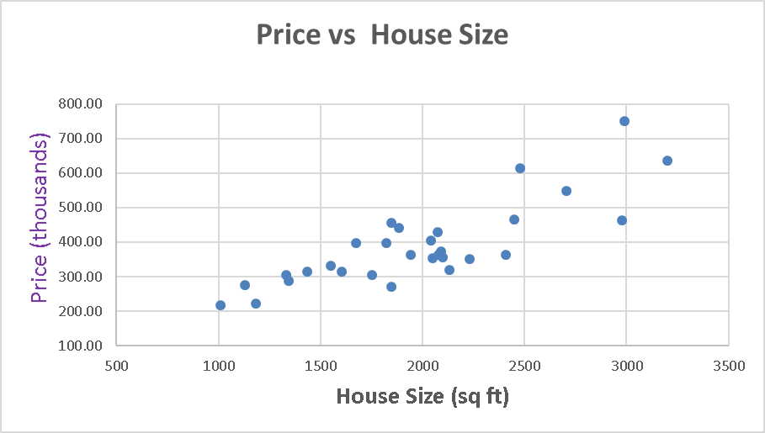
Scatter Plot of sample 30 houses
r = 0.8282

Slide 11
Simple Linear Regression Model
Only one independent variable, X
(ex1: Height, and Weight of human beings)
(ex2: house size (sq. ft.) vs house Price )
Relationship between X and Y is described by a linear function
Changes in Y are assumed to be predictable by changes in X

Slide 12
Population & Sample Regression Models
Notes:
30

Slide 13
Population & Sample Regression Models
Population
☺
☺
☺
☺
☺
Notes:
31

Slide 14

Population & Sample Regression Models
Population
Unknown Relationship
☺
☺
☺
☺
☺
Notes:
32

Slide 15
Population & Sample Regression Models
Population
Random Sample
Unknown Relationship
☺
☺
☺
☺
☺
☺
☺
Notes:
33

Slide 16



Population & Sample Regression Models
Population
Random Sample
Unknown Relationship
☺
☺
☺
☺
☺
☺
☺
Notes:
34

Slide 17
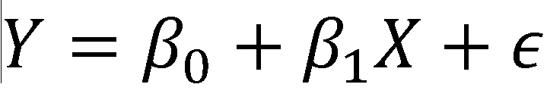
Simple Linear Regression Model
Population Slope Coefficient
Random Error term
Population Y intercept
Independent Variable
Dependent Variable
Linear component
Random Error
component
DATA = Math Model + Random Error

Slide 18

Simple Linear Regression Model
(continued)
Y
Observed Value of Y for X_{i}
ε_{i}
Slope = β₁
Predicted Value of Y for X_{i}
Random Error for this X_{i} value
Intercept = β₀
X_{i}
X

Slide 19
Assumptions of Regression Models
Use the acronym LINE:
Linearity
The underlying relationship between X and Y is linear
Independence of Errors
Error values are statistically independent
Normality of Error
Error values (ε) are normally distributed for any given value of X
Equal Variance (Homoscedasticity)
The probability distribution of the errors has constant variance

Slide 20

Normality of Errors and equal variance
β₀ + β₁ X
X
12
30
68

Slide 21
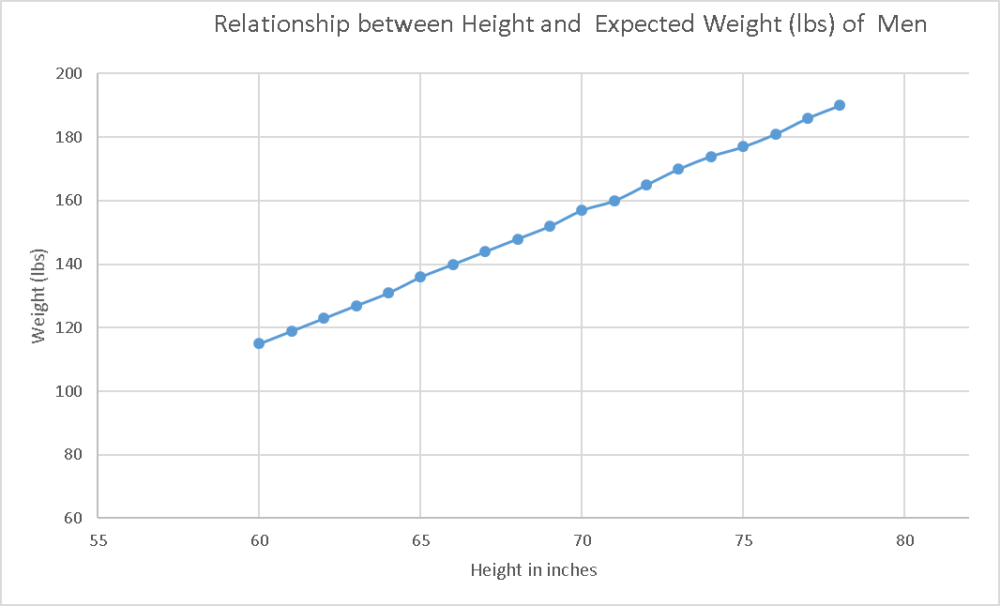


LINE assumptions in Regression
At a height of 70 in, the expected weight is 157 lbs.
may be above or below, Normal (157, std.dev)

Slide 22
Simple Linear Regression Equation (Prediction Line)
The simple linear regression equation provides an estimate of the population regression line
Estimated (or predicted) Y value for observation i
Estimate of the regression intercept
Estimate of the regression slope
Value of X for observation i
The individual random error terms e_{i} have a mean of zero

Slide 23
Scatter Plot
r = 0.8282

Slide 24
Estimate the Regression Equation
If the relationship is exact, all points will be on a line
Scatter diagram shows a situation where the y and x have a strong tendency to increase together but it is not perfect.
How to estimate the coefficients b₀ and b₁ ?
Infinite choice of regression lines to fit
Define a Criteria, for choosing a Line
Use mathematics (calculus) to calculate the coefficients.
We need a technique that will apply even when there are many independent variables

Slide 25
Residuals (Deviations From the Line)
+ deviations
- deviations

Slide 26
Residuals
Figure shows a scatter plot and a possible line fit, where the "fit error" of each point is indicated.
These residuals are positive if the point is above the line and negative if the line is above the point.
We want a technique that will minimize these residuals

Slide 27
Computation Ideas (1)
We can search for a line that minimizes the sum of the residuals:
This is NOT a good idea, because
The +ve deviations, and –ve deviations cancel out, and the the sum may look small

Slide 28
Computation Ideas (2)
By far the most popular approach is to square the residuals and minimize their Sum:
This procedure is called least squares and is widely available in software. It uses calculus to solve for the b₀ and b₁ terms and gives a unique solution.

Slide 29
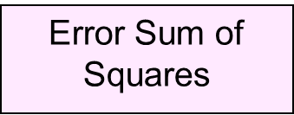
Least Squares Method
b₀ and b₁ are obtained by finding the values of b₀ and b₁ that minimize the sum of the squared differences between Y and :
Value of Y
In input
What the model predicts

Slide 30
Finding the Least Squares Equation
The coefficients b₀ and b₁ , and other regression results can be found using SPSS, Excel or Minitab
Using Excel, b₀ = 31.69, and b₁ = 0.18

Slide 31

Population & Sample Regression Models
Population of
Houses
Random Sample
Unknown Relationship
☺
☺
☺
☺
☺
☺
☺
Notes:
34

Slide 32
Scatter Plot of the sample (30) houses

Slide 33
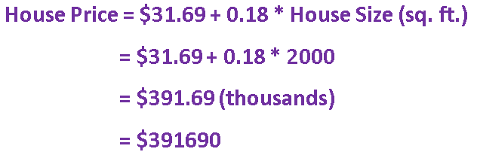

Predictions using Regression Analysis
Predict the price for a house with 2000 square feet:
The predicted price for a house with 2000 square feet is 391.69($1,000s) = $391,690

Slide 34
Interpolation vs. Extrapolation
When using a regression model for prediction, only predict within the relevant range of data
Relevant range for interpolation
Do not try to extrapolate beyond the range of observed X’s

Slide 35
Measures of Variation
Total variation is made up of two parts:
Total Sum of Squares
Regression Sum of Squares
Error Sum of Squares
where:
= Average value of the dependent variable
Y_{i} = Observed values of the dependent variable
_{i} = Predicted value of Y for the given X_{i} value

Slide 36
Measures of Variation
(continued)
SST = total sum of squares
Measures the variation of the Y_{i} values around their mean Y
SSR = regression sum of squares
Explained variation attributable to the relationship between X and Y
SSE = error sum of squares
Variation attributable to factors other than the relationship between X and Y

Slide 37
Measures of Variation
(continued)
Y
Y_{i}
∧
∧
SSE = ∑(Y_{i} - Y_{i} )²
Y
_
SST = ∑(Y_{i} - Y)²
∧
Y
_
∧
_
SSR = ∑(Y_{i} - Y)²
_
Y
Y
X
X_{i}

Slide 38
Coefficient of Determination, r²
The coefficient of determination is the portion of the total variation in the dependent variable that is explained by variation in the independent variable
The coefficient of determination is also called r-squared and is denoted as r²
note:

Slide 39
Examples of Approximate r² Values
Y
r² = 1
Perfect linear relationship between X and Y:
100% of the variation in Y is explained by variation in X
X
r² = 1
Y
X
r² = 1

Slide 40
Examples of Approximate r² Values
Y
0 < r² < 1
Weaker linear relationships between X and Y:
Some but not all of the variation in Y is explained by variation in X
X
Y
X

Slide 41
Examples of Approximate r² Values
r² = 0
Y
No linear relationship between X and Y:
The value of Y does not depend on X. (None of the variation in Y is explained by variation in X)
X
r² = 0

Slide 42

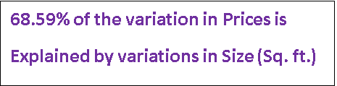
Model Evaluation

Slide 43
Standard Error of Estimate
The standard deviation of the variation of observations around the regression line is estimated by
Where
SSE = error sum of squares
n = sample size

Slide 44
Is the Model Significant? (Simple Regression)
F-Test for Overall Significance of the Model
Shows if there is a linear relationship between all of the x variables considered together and y
Use F test statistic
Hypotheses:
H₀: β₁ = 0 (no linear relationship in the population)
H_{A}: β₁ ≠ 0 (slope of the regression equation not
equal to zero)

Slide 45
Is the Defendant Guilty?
Consider a court trial
Hypotheses:
H₀: Defendant Not Guilty
H_{A}: Defendant is Guilty
Prosecution must show evidence against H_{0,}
Enough evidence to show (beyond reasonable doubt) that Null Hypotheis can not be True
The judge (or jury) may reject Null hyp. If the evidence shows Prob(H₀ ) is very small

Slide 46
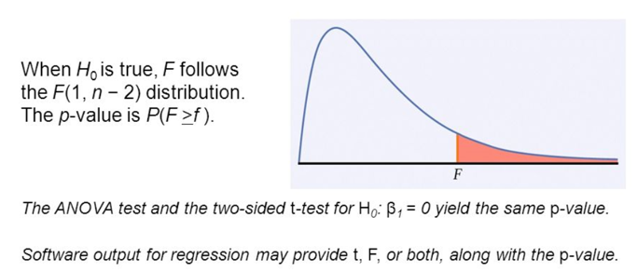
Reject / Accept Null Hypothesis
F Test

Slide 47
Multiple Regression
Select the dependent variable (Target)
Determine the potential independent variables for your model (select the features)
Gather sample data (observations) on features and the Target.
Build MLR model and evaluate the model

Slide 48
The Multiple Regression Model
Population model:
Y-intercept
Population slopes
Random Error
Estimated multiple regression model:
b0, b1, b2, …. coefficients
Estimated
(or predicted)
value of y
Estimated
intercept
Estimated slope coefficients

Slide 49
Multiple Regression Model
Two independent variable model
y
Slope for variable x₁
x₂
Slope for variable x₂
x₁

Slide 50
Multiple Regression Model
Two variable model
y
Sample observation
y_{i}
<
y_{i}
<
e = (y – y)
x_{2i}
x₂
x_{1i}
<
The best fit equation, y ,
is found by minimizing the
sum of squared errors, Σe²
x₁

Slide 51
R² vs. Adjusted R²
R² never decreases when a new x variable is added to the model
This can be a disadvantage when comparing models
What is the net effect of adding a new variable?
We lose a degree of freedom when a new x variable is added
Did the new x variable add enough explanatory power to offset the loss of one degree of freedom?

Slide 52
Is the Model Significant?
F-Test for Overall Significance of the Model
Shows if there is a linear relationship between all of the x variables considered together and y (in the Population)
Hypotheses:
H₀: β₁ = β₂ = … = β_{k} = 0 (no linear relationship)
H_{A}: at least one β_{i} ≠ 0 (at least one independent
variable affects y)
Use F test statistic

Slide 53
F Test for Significance
F Test statistic:
where
where F follows an F distribution with k numerator and (n – k - 1) denominator degrees of freedom
(k = the number of independent variables in the regression model)

Slide 54
Are all the independent variables needed?
Suppose the F-test shows that the linear model is SIGNIFICANT. We can then use the model to make predictions with the model.
Can the model be improved?
Question: Are all the independent variables needed? Is it likely that one more independent variables can be eliminated without reducing the predictive power of the model?
t-tests can be used to answer the above question

Slide 55
Are Individual Variables Significant?
Do we need all the independent Variables in the model?
Use t-tests for individual variable slopes
Shows if there is a linear relationship between the variable x_{i} and y
Hypotheses:
H₀: β_{i} = 0 (no linear relationship)
H_{A}: β_{i} ≠ 0 (linear relationship does exist
between x_{i} and y)

Slide 56
Inference about the Slope: t Test
t test for a population slope
Is there a linear relationship between X and Y in the Population?
Null and alternative hypotheses
H₀: β₁ = 0 (no linear relationship)
H₁: β₁ ≠ 0 (linear relationship does exist)
Test statistic
where:
b₁ = regression slope
coefficient
β₁ = hypothesized slope
S_{b} = standard
error of the slope
1

Slide 57
Multiple Regression Example

Slide 58
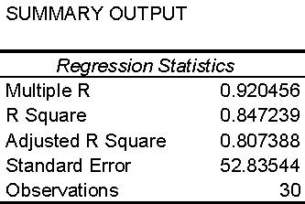
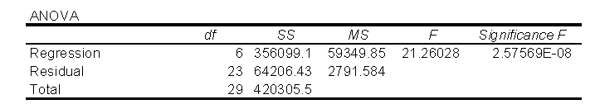
F-Test for Overall Significance
(continued)

Slide 59
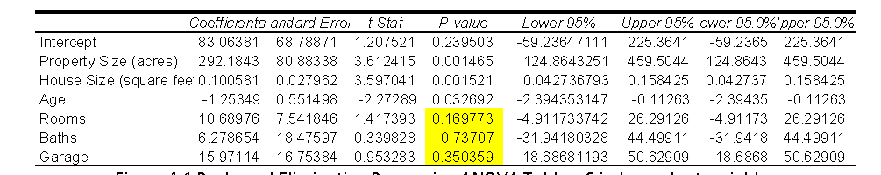
t- tests
Test significance of each independent variable

Slide 60
Demo with Excel and SPSS Modeler

Slide 61
Residual Analysis
The residual for observation i, e_{i}, is the difference between its observed and predicted value
Check the assumptions of regression by examining the residuals
Examine for linearity assumption
Evaluate independence assumption
Evaluate normal distribution assumption
Examine for constant variance for all levels of X (homoscedasticity)
Graphical Analysis of Residuals
Can plot residuals vs. X

Slide 62
Residual Analysis for Linearity
Y
Y
x
x
residuals
x
x
residuals
Not Linear
✓
Linear

Slide 63
Residual Analysis for Independence
Not Independent
✓
Independent
residuals
X
residuals
X
residuals
X

Slide 64
Residual Analysis for Normality
A normal probability plot of the residuals can be used to check for normality:
Percent
100
0
-3 -2 -1 0 1 2 3
Residual

Slide 65
Residual Analysis for Equal Variance
Y
Y
x
x
residuals
x
x
residuals
✓
Non-constant variance
Constant variance

Slide 66
F-test for the overall fit of the model
To test the statistical significance of the regression relation between the response variable y and the set of variables x₁,…, x_{k}, i.e. to choose between the alternatives:
We use the test statistic:

Slide 67
Slope and Intercept
For a given set of data, we need to calculate values for the slope b₁ and the intercept b₀.
Scatter diagram shows the graph of a set of 30 (x, y) pairs that have an inexact relationship.
How to estimate b₀ and b₁ ?

